Slide 1

Intelligent Threat Detection: AI-Based Weapon Recognition with Automated AWS Security Notifications
Pulkith Reddy Chinaganta 900836098
Vinay Goud Oruganti 900837367

Slide 2
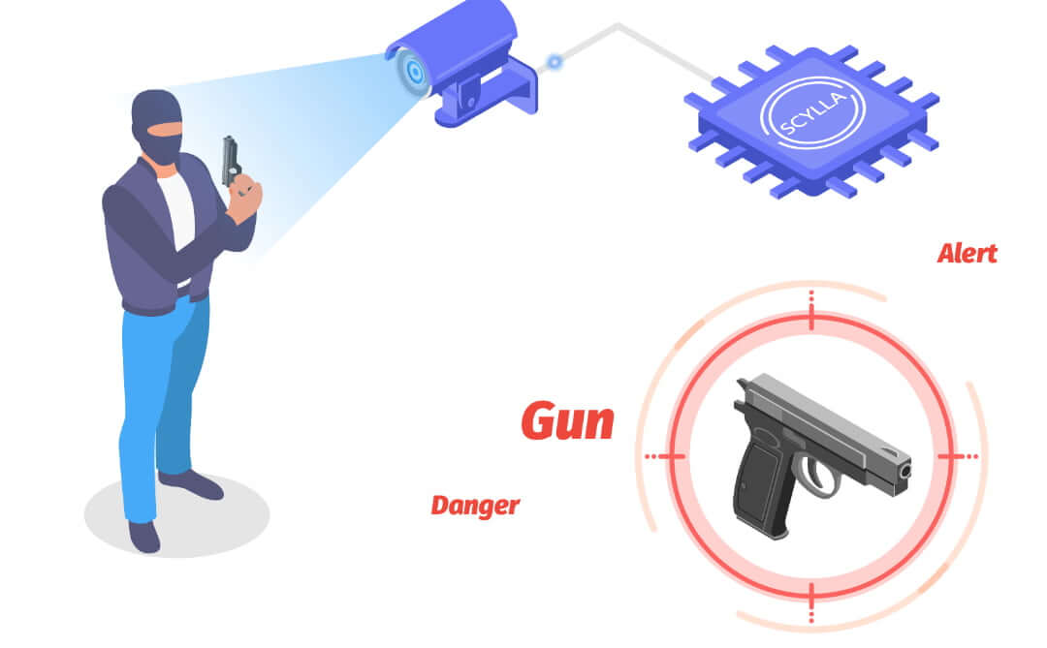
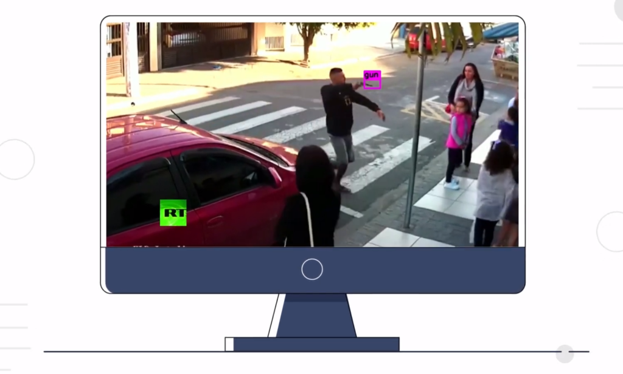
AI-Powered Weapon Detection System
Uses YOLOv5 architecture enhanced with custom detection algorithms.
Achieves 85% accuracy in identifying potential threats
Delivers real-time alerts through AWS SNS integration
Provides seamless security monitoring with minimal false positives

Slide 3

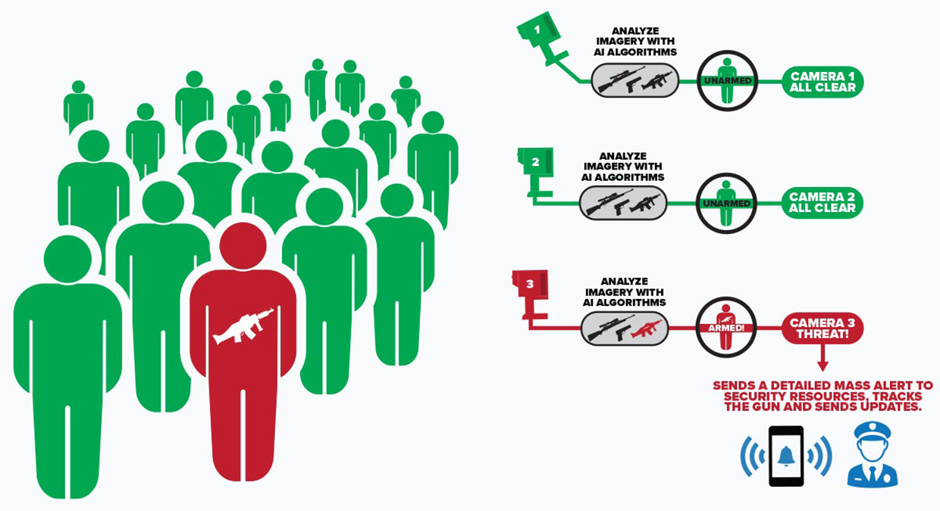
Purpose & Problem Statement
Enhance surveillance with AI: Use AI to make video monitoring smarter and more efficient.
Detect threats in live and recorded video: Identify weapons in both real-time and saved video feeds.
Augment human monitoring: Support security teams with automated threat alerts.

Slide 4
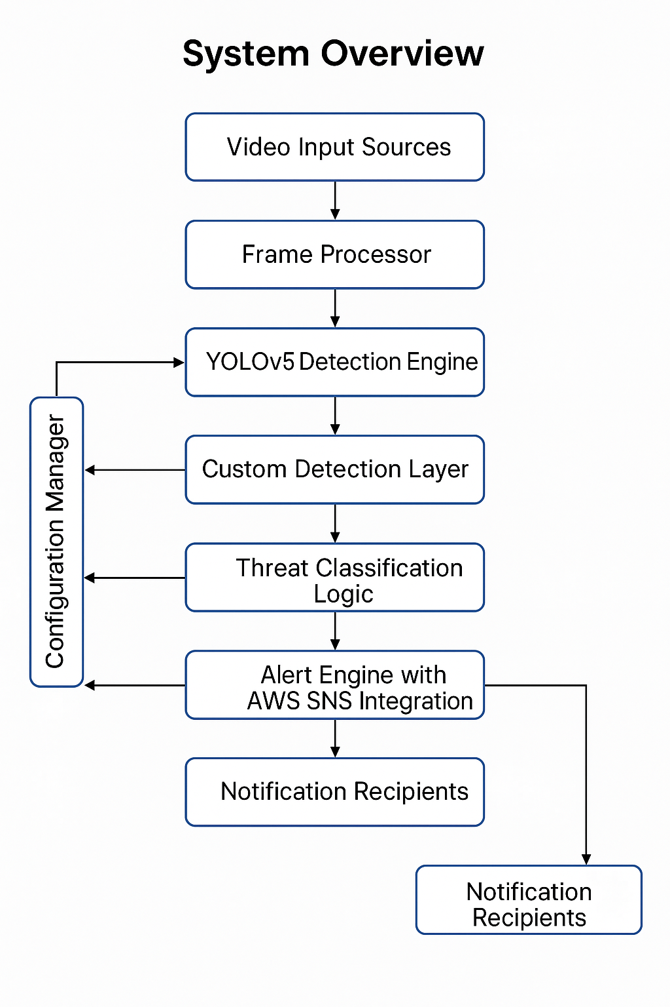
System Architecture Diagram

Slide 5
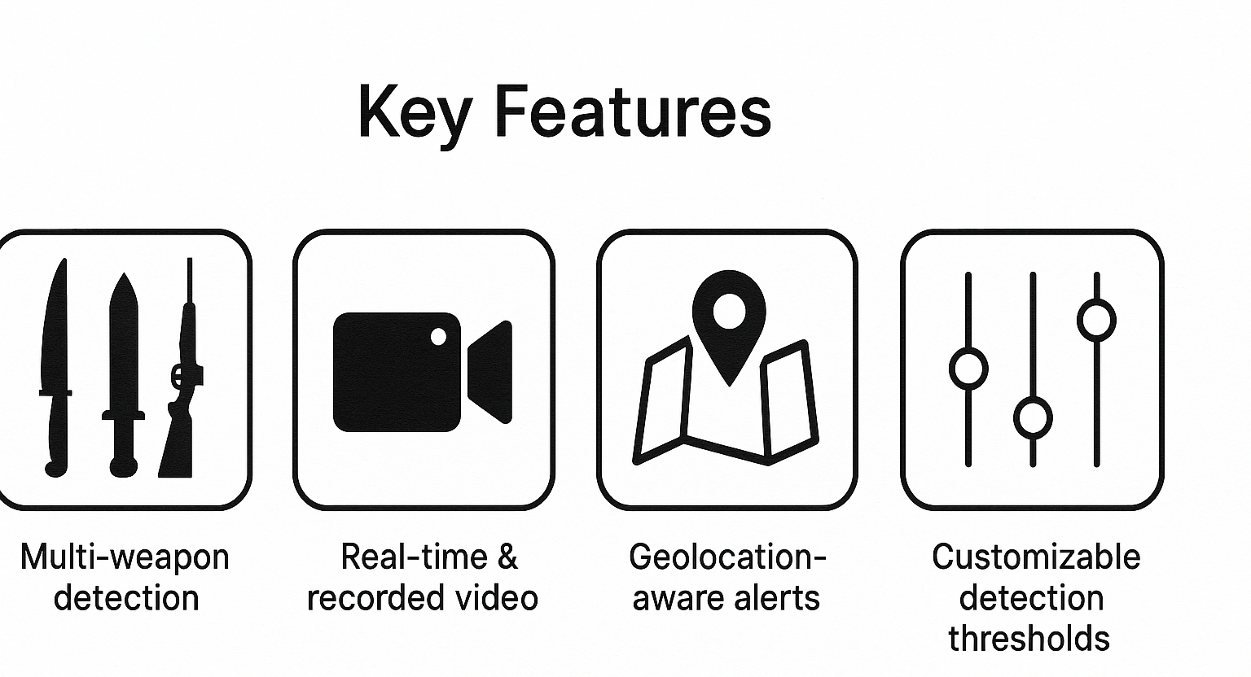
Key Features
Geolocation-aware alerts: Each detected threat is tagged with the approximate location using IP-based geolocation, helping responders act quickly and accurately.
Customizable detection thresholds: Security teams can adjust detection sensitivity and confidence levels to suit different environments and reduce false alarms.
Multi-weapon detection (knives, bats, rifles): The system can accurately identify various types of weapons, including common handheld items and long-barrel rifles, using both AI models and custom detection logic.
Real-time & recorded video support: It works seamlessly with both live camera feeds and pre-recorded videos, offering flexibility for active monitoring and post-event analysis.

Slide 6

Detection Pipeline
1. Frame Capture
The system captures individual frames from either a live camera feed or a recorded video source to be analyzed one at a time.
2. YOLOv5 Detection
Each frame is passed through the YOLOv5 (You Only Look Once v5) deep learning model to detect common weapon objects like knives, bats, and bottles.
3. Rifle Detection Logic
For weapons not well-covered in pre-trained models (like rifles), a custom algorithm analyzes line patterns and shapes to detect long-barrel firearms.
4. Threat Classification
Detected objects are evaluated based on confidence levels and proximity to people, helping determine whether an alert should be triggered.
5. AWS SNS Alerts
If a threat is confirmed, an automated alert is sent using Amazon Web Services Simple Notification Service (AWS SNS), which delivers messages via SMS, email, or other endpoints along with image evidence and location data.

Slide 7
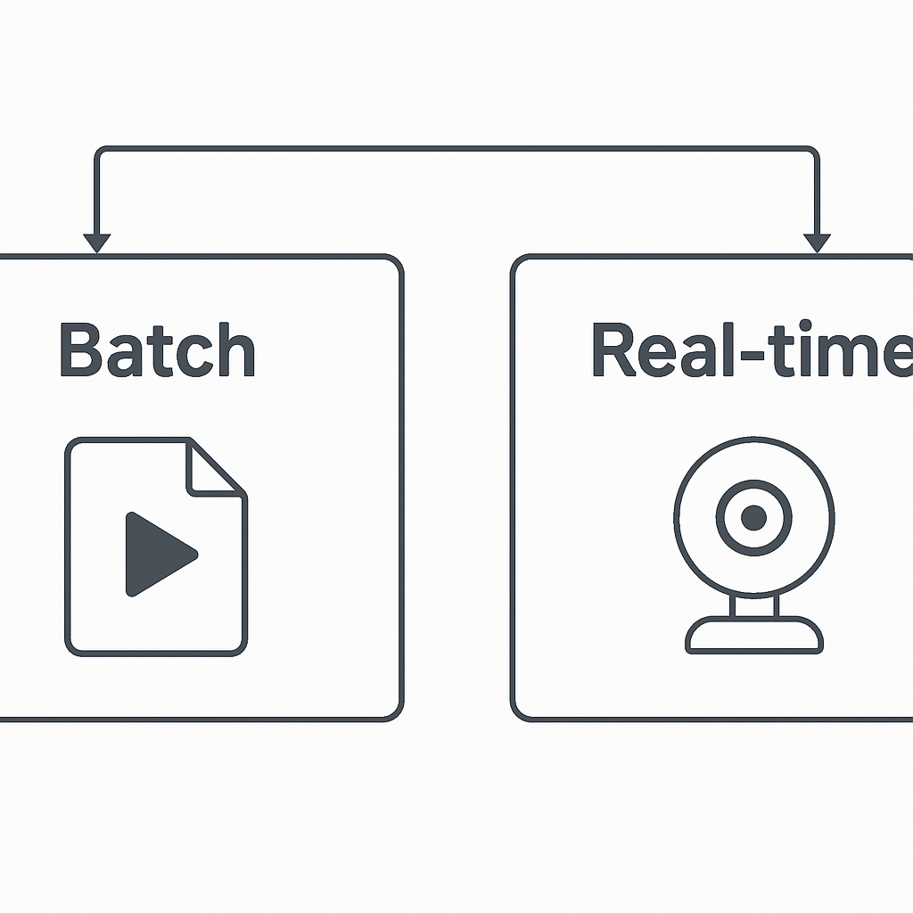
Dual Detection Modes
Batch Mode: Recorded Video Files
This mode processes pre-recorded video files, analyzing each frame sequentially. It is useful for post-incident analysis, audit trails, and offline threat evaluation.
Real-time Mode: Live Webcam Feed
This mode enables continuous surveillance using a live camera stream. It is designed for active monitoring environments where immediate alerts and visual feedback are critical.

Slide 8
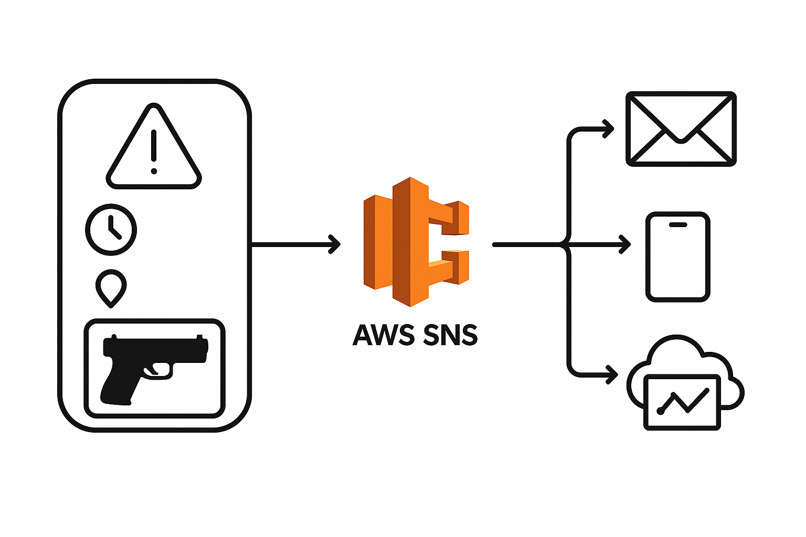
Alert Notification System
Alert Components: When a weapon is detected, the system generates an alert with the following details:
Timestamp: The exact time of detection.
Location: The location where the weapon was detected.
Image: A snapshot or video frame of the detected weapon.
Alert Delivery: The alert is then sent via multiple channels using AWS SNS:
Email: Sends the alert to designated email addresses.
SMS: Notifies users through text messages.
Cloud Dashboards: Displays the alert in real-time on a cloud-based monitoring system for live tracking.
This system ensures that once a weapon is detected, an alert is quickly created and sent to the relevant parties for immediate action.

Slide 9
Use Cases for AI-Powered Weapon Detection System
Public Venues: Enhancing security at stadiums, concert halls, and convention centres by scanning crowds for concealed weapons.
Educational Institutions: Protecting schools and universities with discreet monitoring systems at entry points.
Government Buildings: Strengthening security protocols at courthouses, legislative buildings, and other sensitive facilities.
Transit Hubs: Monitoring airports, train stations, and bus terminals for potential threats without disrupting passenger flow.
Commercial Properties: Securing shopping malls, office buildings, and banks with non-intrusive weapon detection.
Event Security: Providing additional safety measures for festivals, parades, and large public gatherings.
Critical Infrastructure: Protecting power plants, water facilities, and communications centers from unauthorized armed access.
Healthcare Facilities: Enhancing safety in hospitals and medical centers while maintaining a welcoming environment.

Slide 10
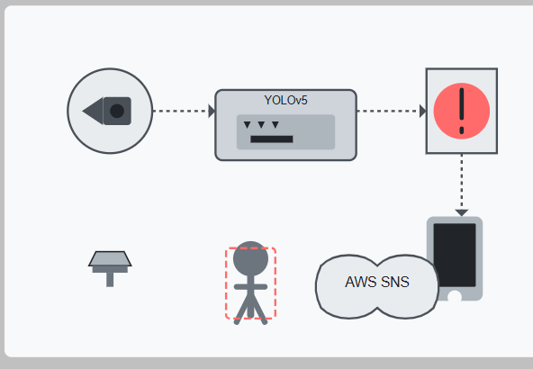
AI-Powered Weapon Detection System: Summary
Advanced security solution utilizing YOLOv5 architecture with 85% detection accuracy
Real-time threat alerts delivered seamlessly through AWS SNS integration
Versatile applications across public venues,
schools, transit hubs, and critical infrastructure
Enhances public safety with minimal
disruption while reducing security personnel
requirements

Slide 11


